Slide 1

SENTIMENT ANALYSIS USING TWITTER
TEAM 8:
SAGAR TANNA
PRIYANKABEN SHIYANI
EJONA KOCIBELLI
AKSHAY LAVHAGALE

Slide 2

Team Members

Slide 3
Presentation Agenda
Introduction
Technologies Used
Data Description & Preprocessing
Exploratory Data Analysis
Performance Evaluations
Scope Evaluations
Conclusion

Slide 4
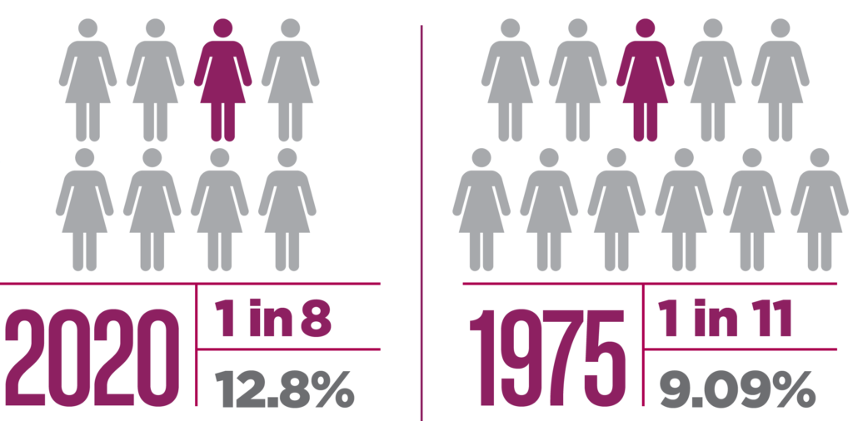
Introduction
Why Breast Cancer?
Breast cancer is the most common cancer among women in the United States. Breast cancer is the second most common cause of death from cancer in women in the United States, after lung cancer.
It is estimated that 42,690 deaths (42,170 women and 520 men) from breast cancer will occur this year, more than the no. of deaths due to COVID-19 in Texas and California combined.

Slide 5


Introduction
How would this help?
The aim of our project is:
To analyze people’s attitudes (i.e., emotions) towards breast cancer.
How do people’s attitudes towards breast cancer differ across geospatial regions?
Can we identify latent topic trends and hashtags in breast cancer-related tweets?
Using all this information, we can help show the results of our analysis in order to create an awareness of the perception and attitude of the people towards it on social media, helping bring about a change and how social media like TWITTER could be of help to bring that change.

Slide 6





Technologies Used
For collecting tweets data using Twitter API
For sentiment scores
For parallel processing
+
For server-side parallelization
Notes:
Tweepy - Twitter Developer account to scrape the data
Amazon EMR - Creating different clusters to run the code
Amazon S3 - Created buckets to keep our dataset
TextBlob - We used TextBlob libraries to give scores to the sentiments.
We used Pyspark as the code to perform parallel processing on EMR clusters.

Slide 7
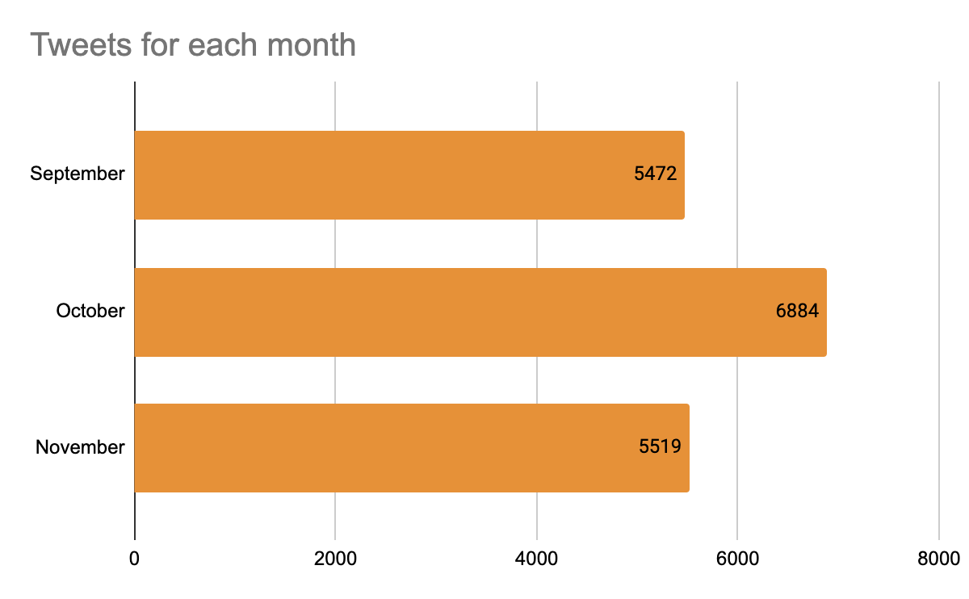
Data Description
The total dataset we collected has 17887 rows and 9 columns
Monthly datasets:
September: 5472 rows
October: 6884 rows
November: 5519 rows
The columns refer to:
Tweet ID – The unique id of each tweet
Tweet Date – Time and date that the tweet was posted
Tweet Content – The original uncleaned content of each tweet
Sentiment – The score given to each tweet using the Textblob library
Language – The language of the tweet
Retweet Count – The number of retweets that the tweet had
Hashtags – The hashtags that were included in the tweet content
Location – The location where the tweet was posted
Classes – A categorical variable that classified tweet into 0,1,2 categories which corresponded to Negative, Neutral and Positive sentiment, respectively. This variable was the target variable for the machine learning model
Notes:
We used this data to:
• Train the machine learning model
• Analyze the trend of opinion of masses on breast cancer
• Analyze how do people’s attitudes towards breast cancer differ across geospatial regions
• Identify latent topic trends and hashtags in breast cancer related tweets

Slide 8
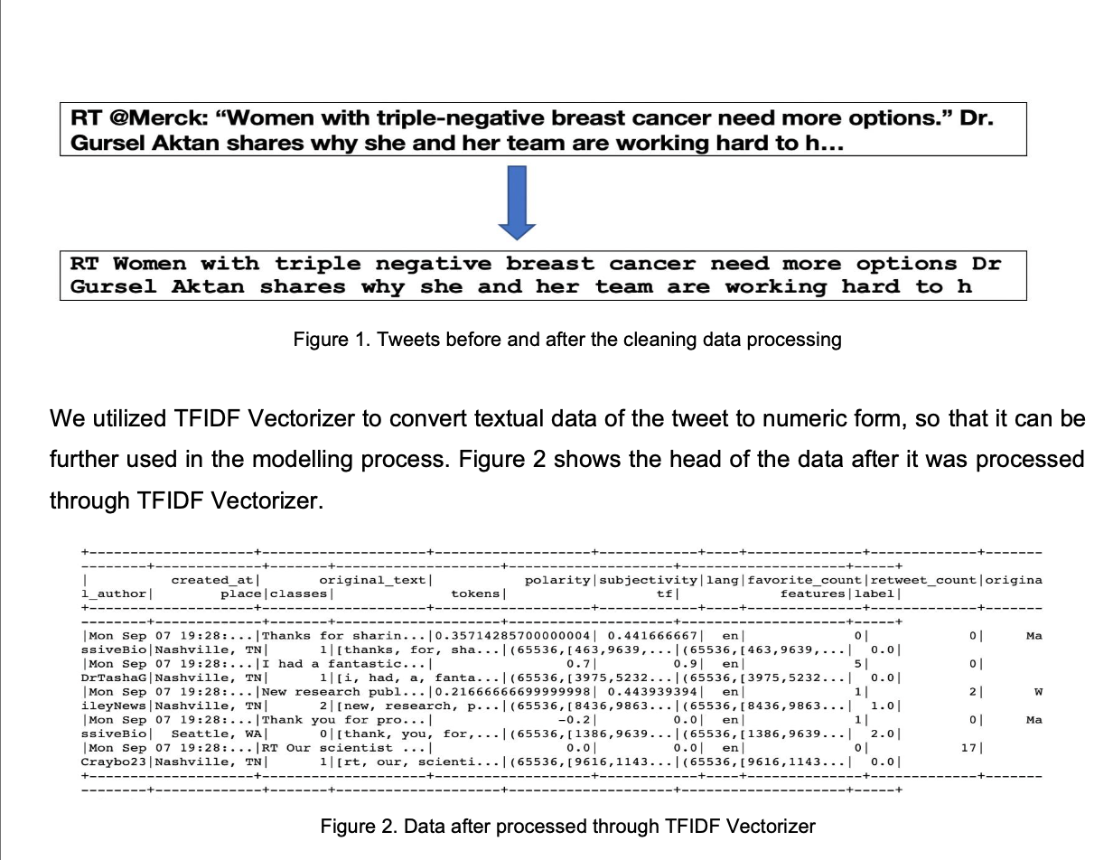
Data Preprocessing
Two main conditions we followed while collecting data were:
Location was only restricted to within United States
Only tweets in English were scraped.
Columns related to any missing values were deleted.
Duplicated data was deleted.
Data was cleaned using REGEX and converted to TF-IDF vectors

Slide 9

Data Analysis
Used three popular algorithms for classification:
Logistic Regression,
Decision Trees and
Random Forests.
Created AWS EMR clusters:
1 instance (no parallel processing),
3 instances, 5 instances and 7 instances
We split the data into 30%, 50%, 70% and 90% of the data and the rest we considered as test data.
Amazon S3 services to store the datasets.
Notes:
2. To assess the performance of our models using parallel processing as compared to different clusters with different number of instances but also compared it with using a single processor (1 instance cluster).
3.We imported the Pyspark modules of our three algorithms and ran our training datasets with its features (tf-idf vectors) with the labels (0,1,2 classes) on these models. We noted down the accuracies and the time taken to run these steps. We terminated the cluster (3 instances) and repeated the same steps over by creating other clusters: 1 instance cluster (no parallel processing), 5 instances cluster, 7 instances cluster.

Slide 10
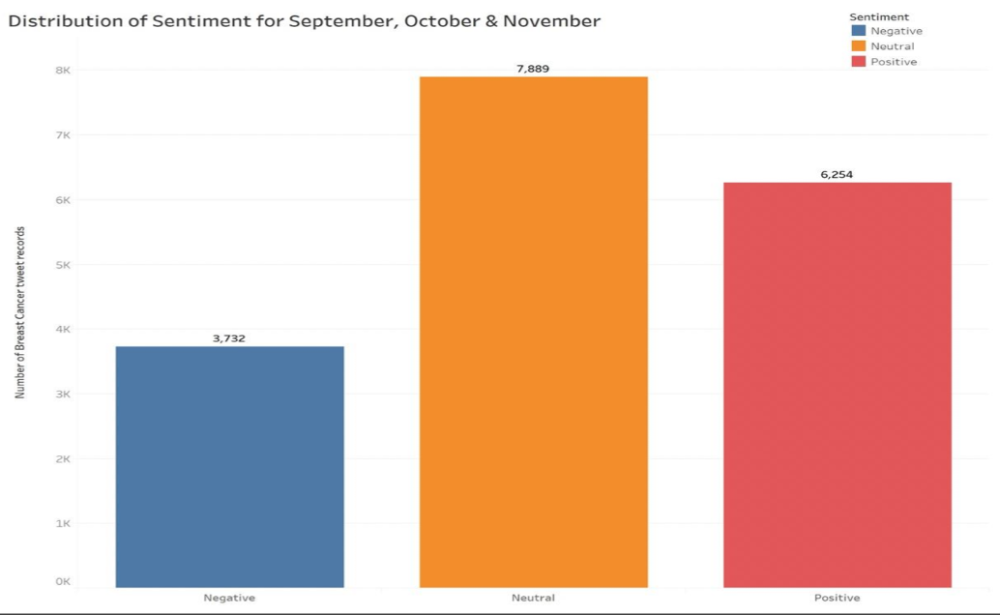
Exploratory Data Analysis
After all the preprocessing and using TextBlob for the sentiment scores and classifying the data based on classes 0,1 and 2, we get the following distributions:
As discussed in the introduction of the presentation, the main aim of this project is to answer those 3 important questions. Here, we try to answer the 3 questions in the :

Slide 11
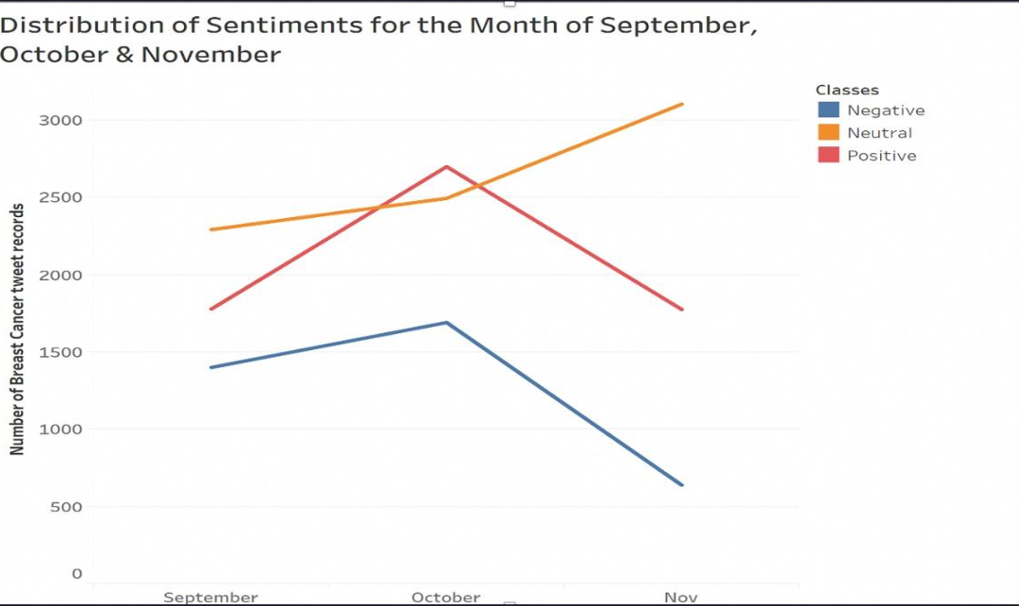
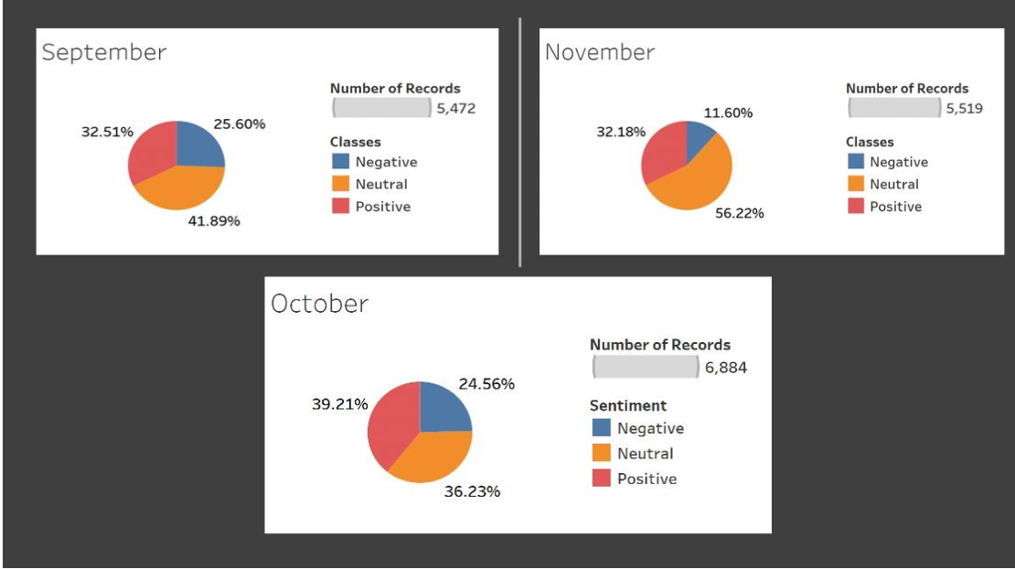
Scope Evaluations
What is the trend of people’s emotions/ attitude towards Breast Cancer over time?
For the most part, the sentiment of the people was neutral.
We can see the gradual increase in the sentiments from the month of September to October. On further digging in, we find this is because October is the “Breast Cancer Awareness Month”
The pie diagrams show the distribution of the sentiments for the respective months

Slide 12
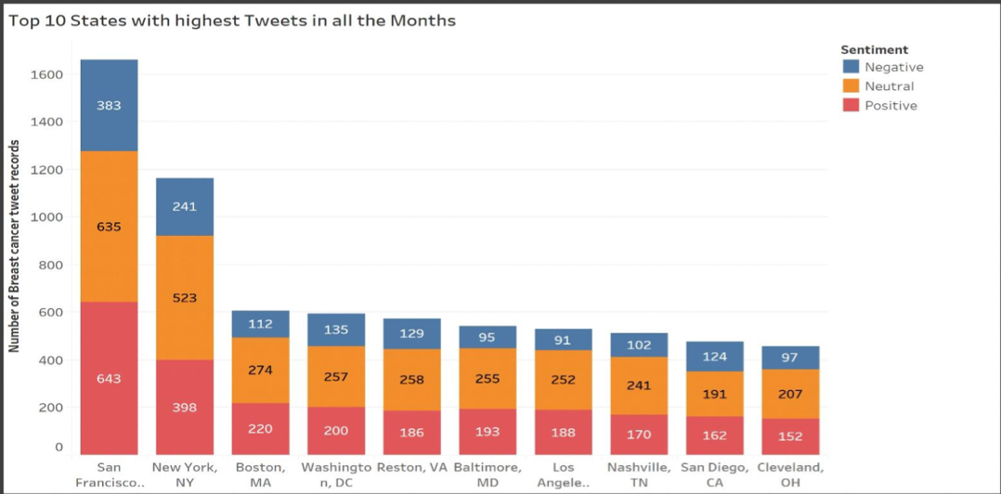
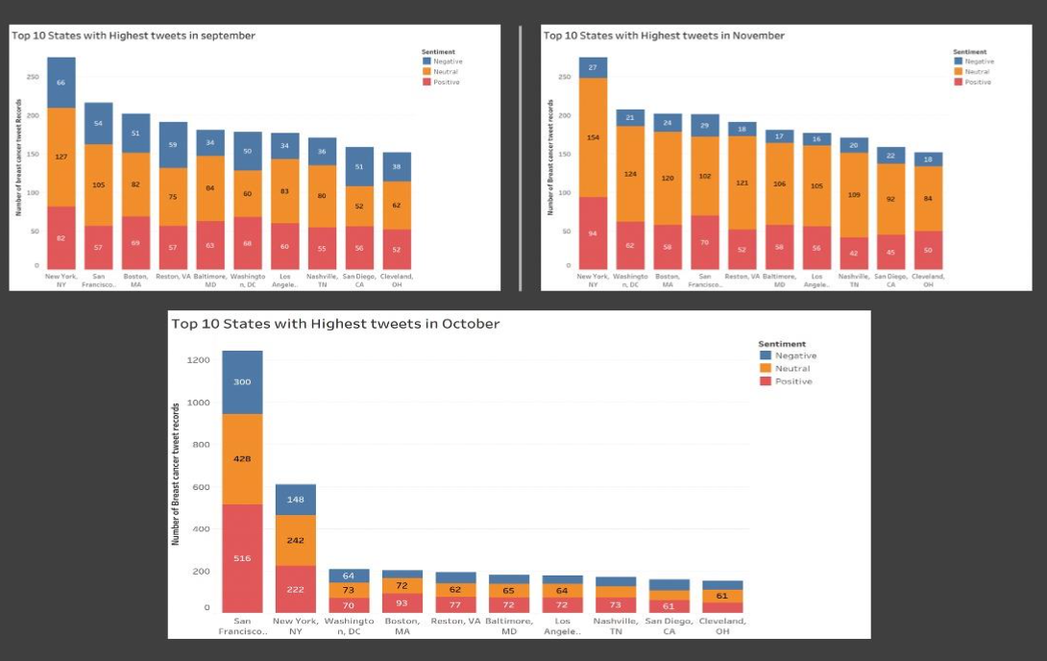
Scope Evaluations
How do people’s attitudes towards breast cancer differ across geospatial regions?
The bar chart above shows us that San Francisco and New York are 2 cities that show the most number of engagement throughout. We see a trend that the engagement is high in large metro cities as compared to the small towns.
The monthly distributions tell the same story, with more for positive sentiment for New York and San Francisco respectively.

Slide 13
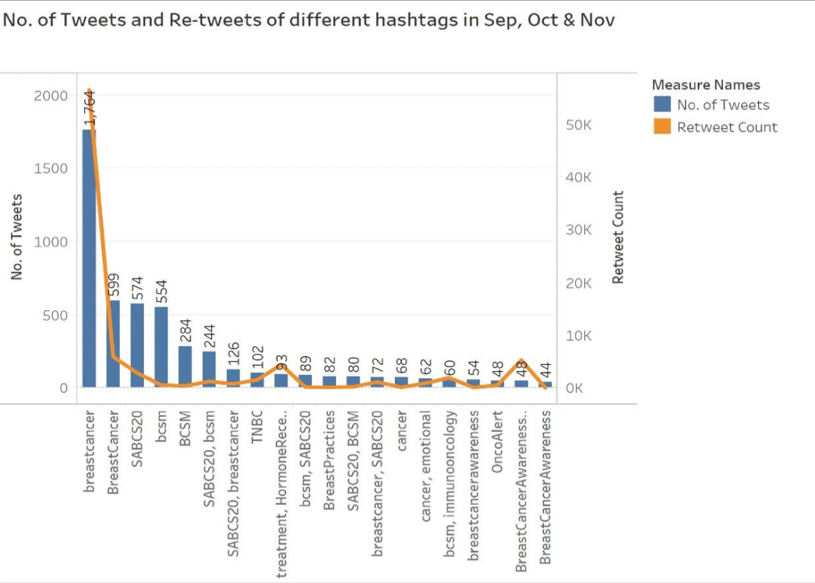
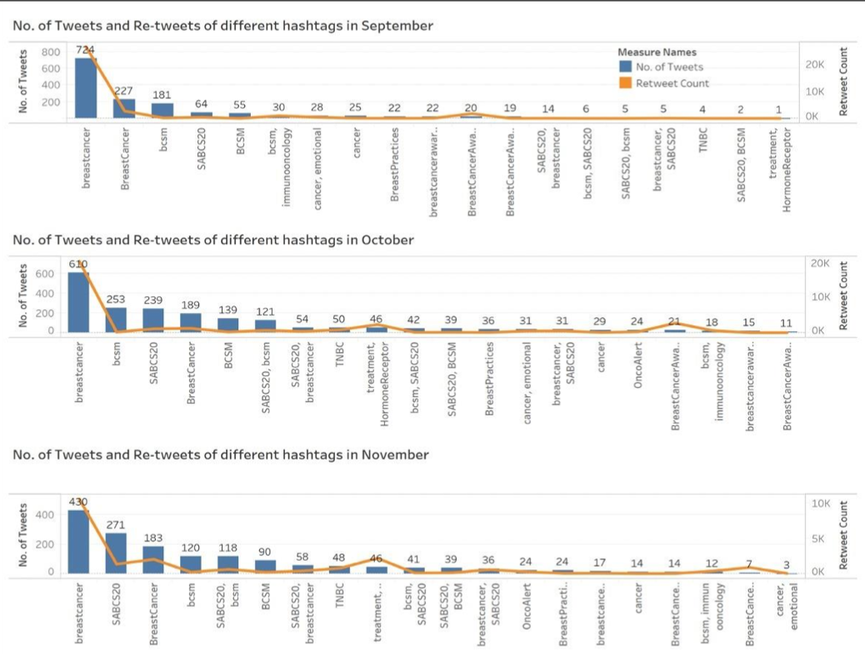
Scope Evaluations
Can we identify latent topic trends and hashtags in breast cancer-related tweets?
We try to answer this question by identifying the highest number of hashtags on breast cancer along with the no. of retweets for each of them.
We can see that the hashtags #breastcancer is the most trending followed by #BreastCancer, #bcsm and #SABCS20 as shown in the diagrams.

Slide 14
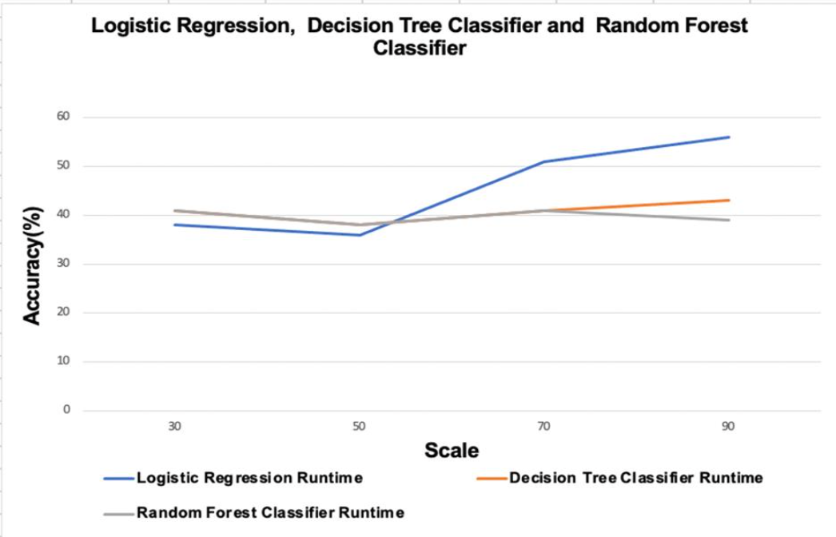
Performance Evaluations
Impact of Scale on Quality of Analysis
In scale, we split the data into 30%, 50%, 70% and 90% of the data and the rest we considered as test data.
From graph, it is noticeable that Logistic Regression is greater than Decision Tree and Decision Tree is greater than Random Forest. The reason behind that is the performance of Random Forest will be low when the number of features is less in the data set. In our breast cancer data set we only have one feature ‘original text’.
On the other hand, Logistic regression is known to perform better with lower dimensional data and also, Random forests are an ensemble of weak decision trees. But still together they perform better than just a one single decision tree. Overall, we had highest accuracy by using Logistic Regression algorithm.

Slide 15
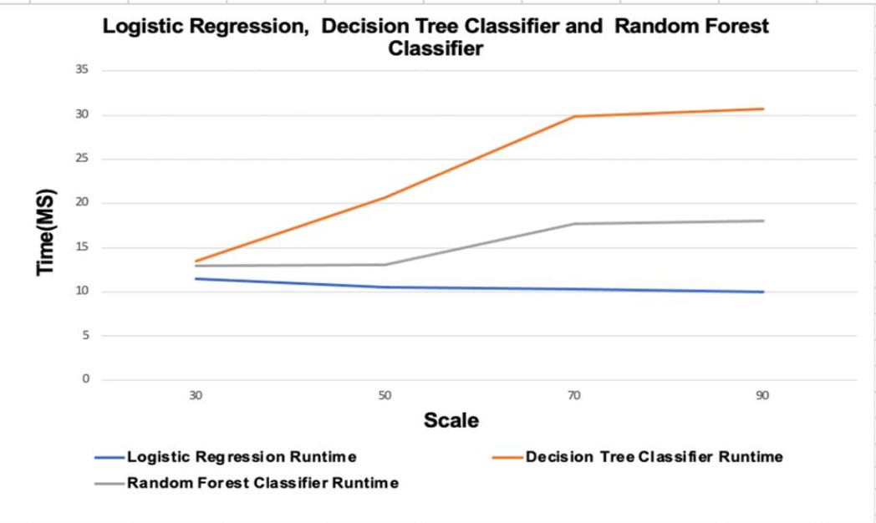
Performance Evaluations
Impact of Scale on Performance
From graph we can see that Logistic regression are much faster than decision trees classifier and Random forest classifier. We split the dataset into subsets of data 30%, 50%, 70% and 90% to compare the time performance of each subset of data using the three algorithms.
For instance, when we ingested the 30% of data into each algorithm then we noticed that time is between 10 to 15 seconds in all algorithms but after ingesting the 90% of data into each algorithm we noticed that the time difference increased between all three algorithms.
Decision trees classifier’s performance is slowest in all three algorithms.

Slide 16
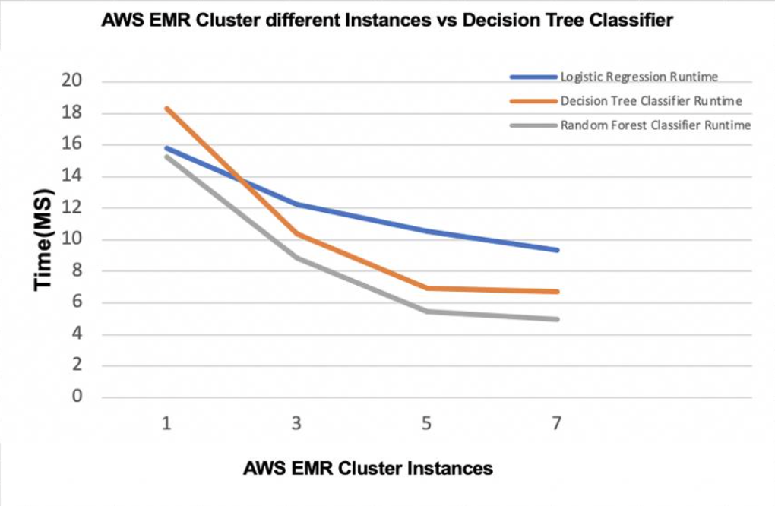
Performance Evaluations
Impact of Parallel Computation on Performance
Here, we used AWS EMR cluster with 1 instance cluster (no parallel processing), 3 instance cluster, 5 instance cluster, 7 instance cluster.
In the graphs we can see that using cluster with 1 instance cluster (no parallel processing) and 3 instance cluster took more time than other clusters with 5 and 7 instances cluster.
The cluster with 7 instances gave the better performance and it took less time compare to other three clusters.

Slide 17

Conclusion
In conclusion, we identified and collected all the tweets which are related to breast cancer using hashtags.
After successfully cleaning and processing the data, we modeled the information gathered and then we applied various sentiment analysis techniques which helped us to get better understanding for the perceptions and emotions which the Twitter users have towards breast cancer.

Slide 18
